Slide 1

Project 1: How does a complex community collaboratively ferment macronutrients?

Slide 2
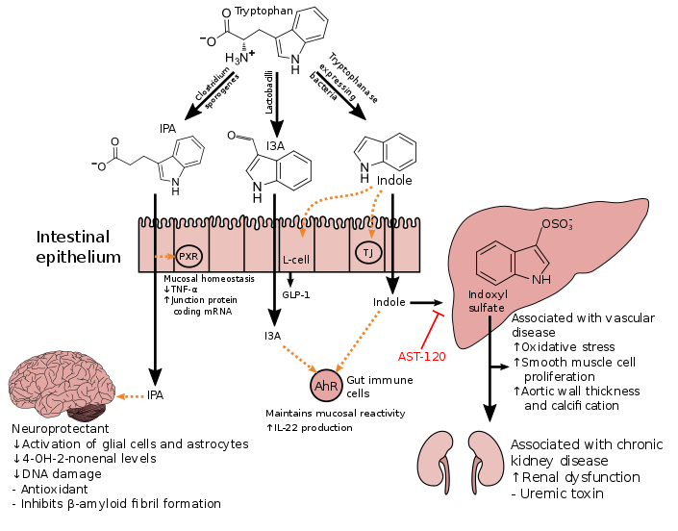
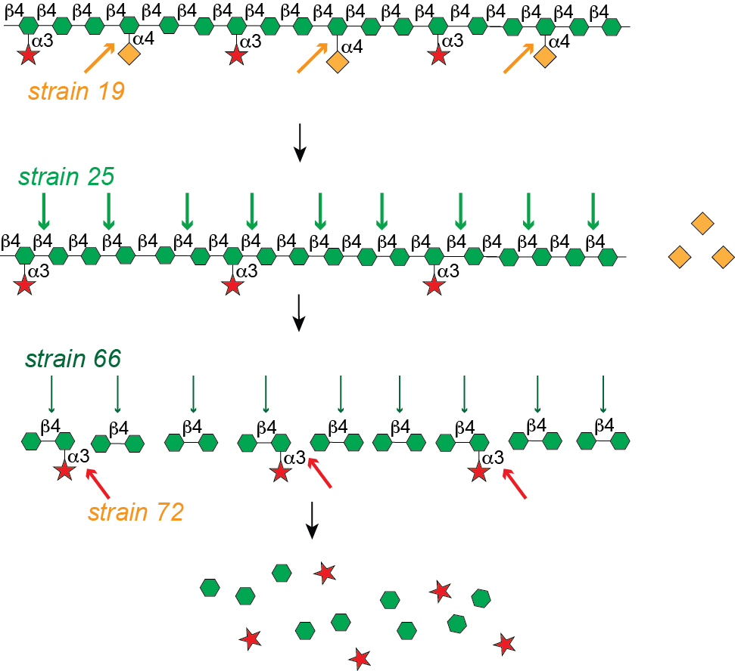
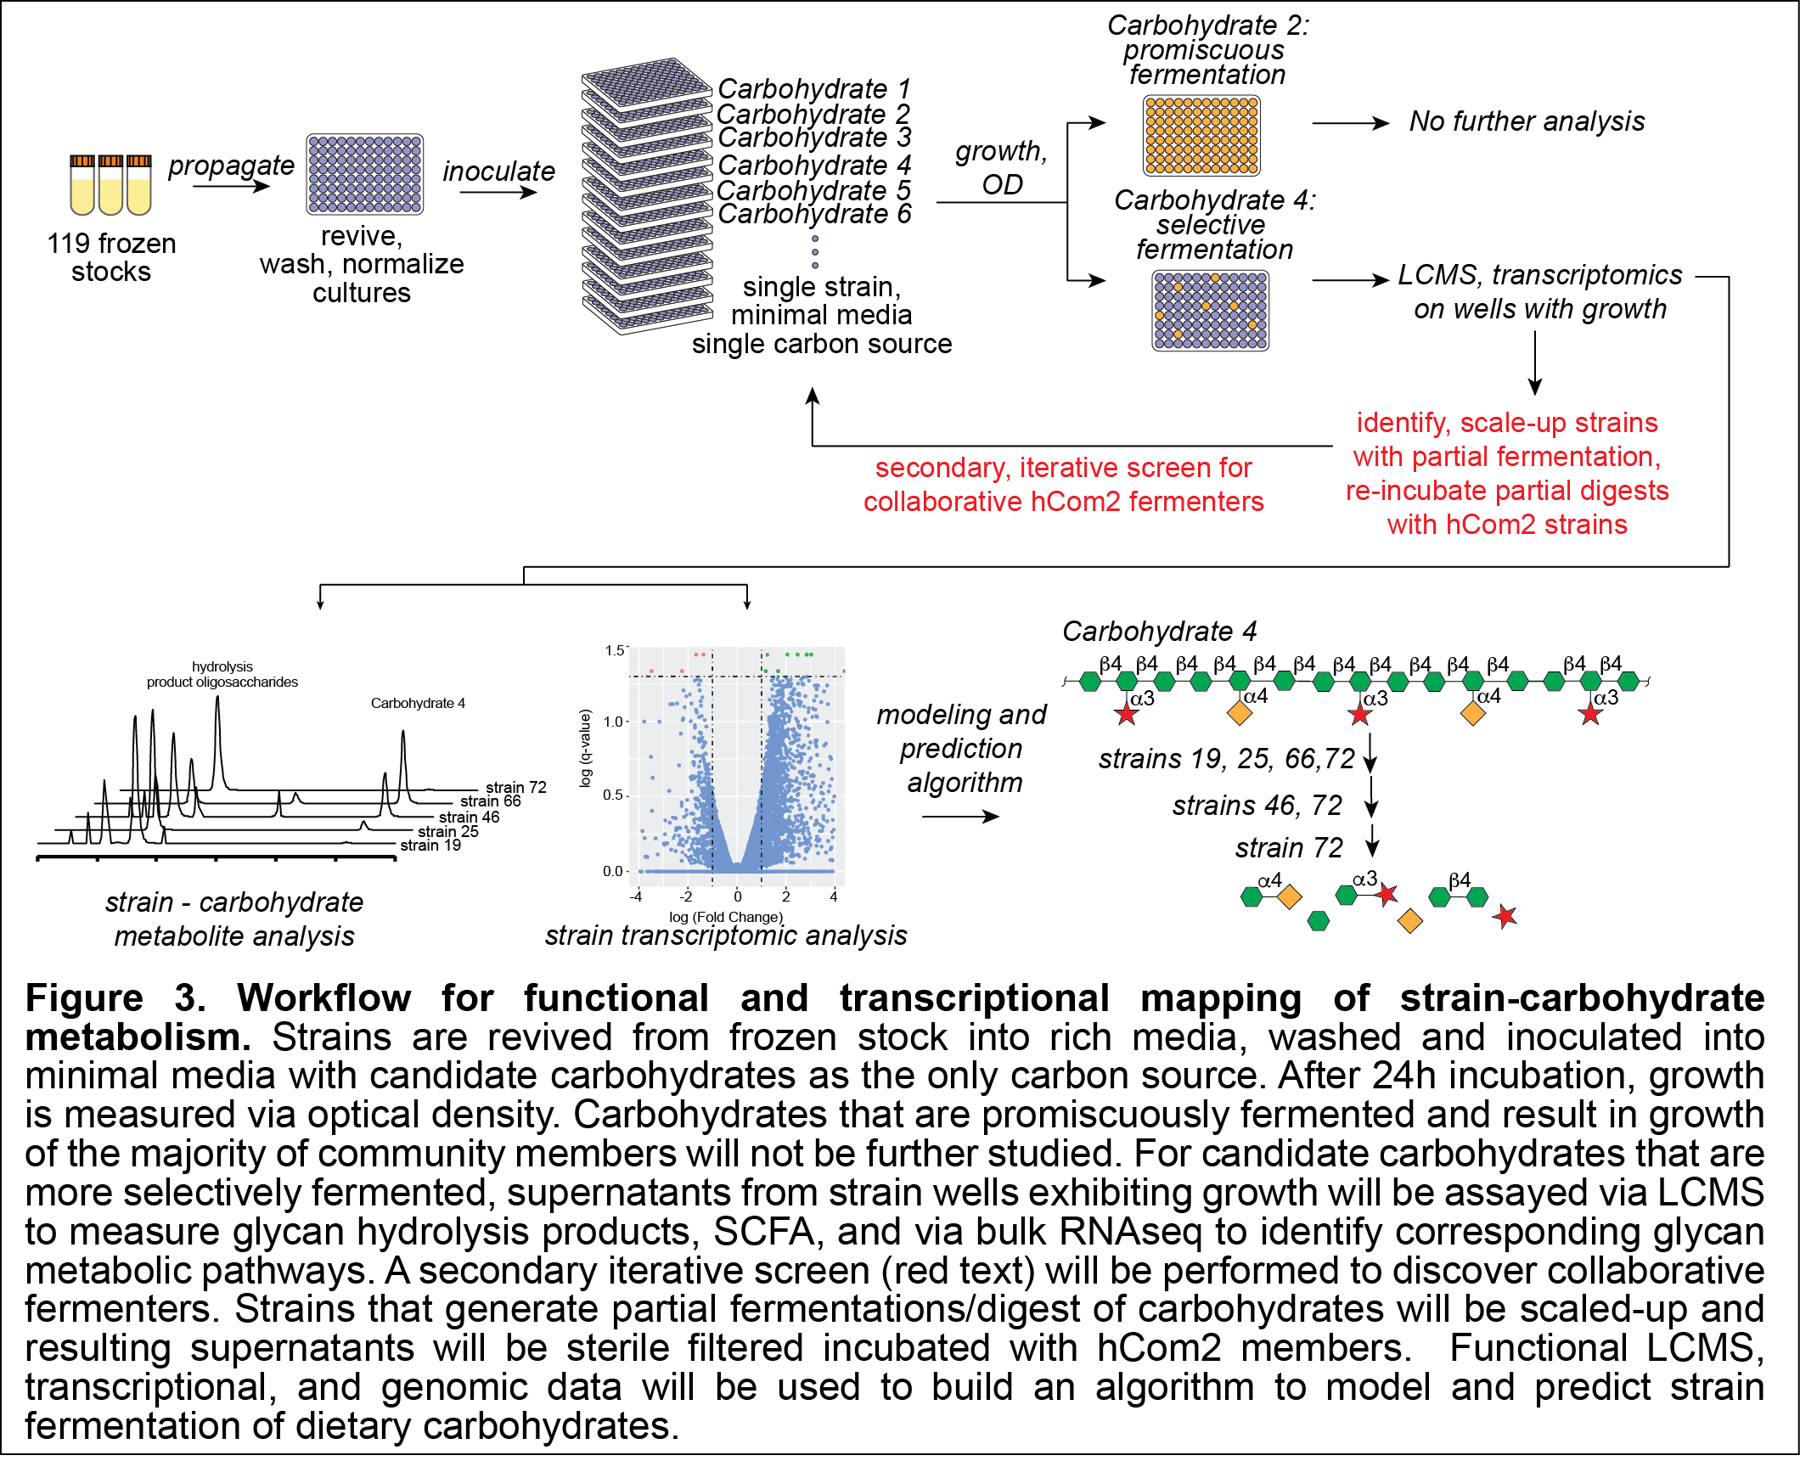
Collaborative Fermentation
Clostridium sporogenes
Strains 19, 25, 66, 72

Slide 3
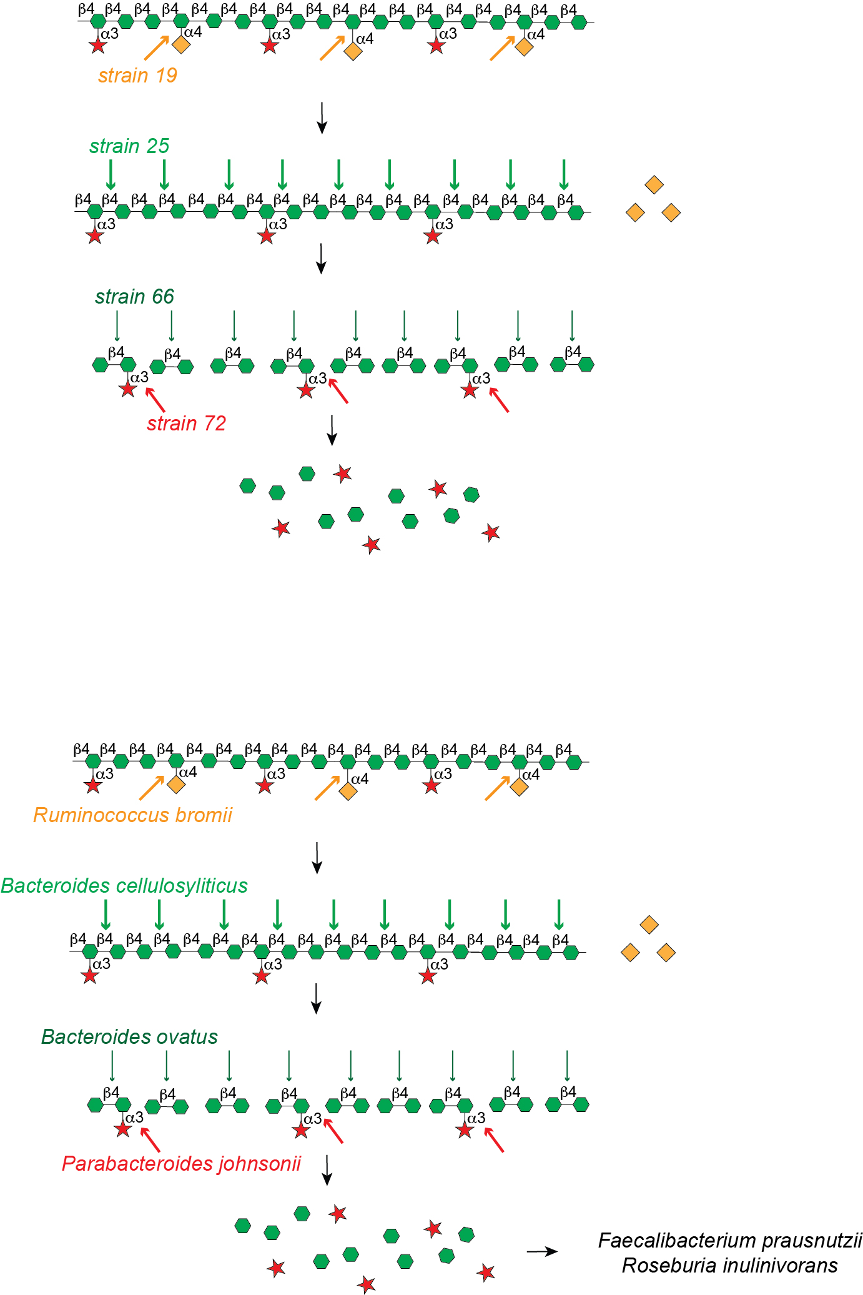
Collaborative Fermentation

Slide 4
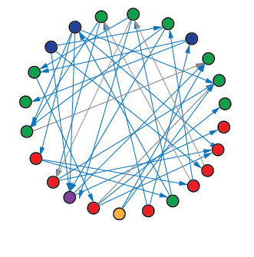
Collaborative Fermentation
Keystone strains
Secondary metabolizers
Crossfeeding strains

Slide 5
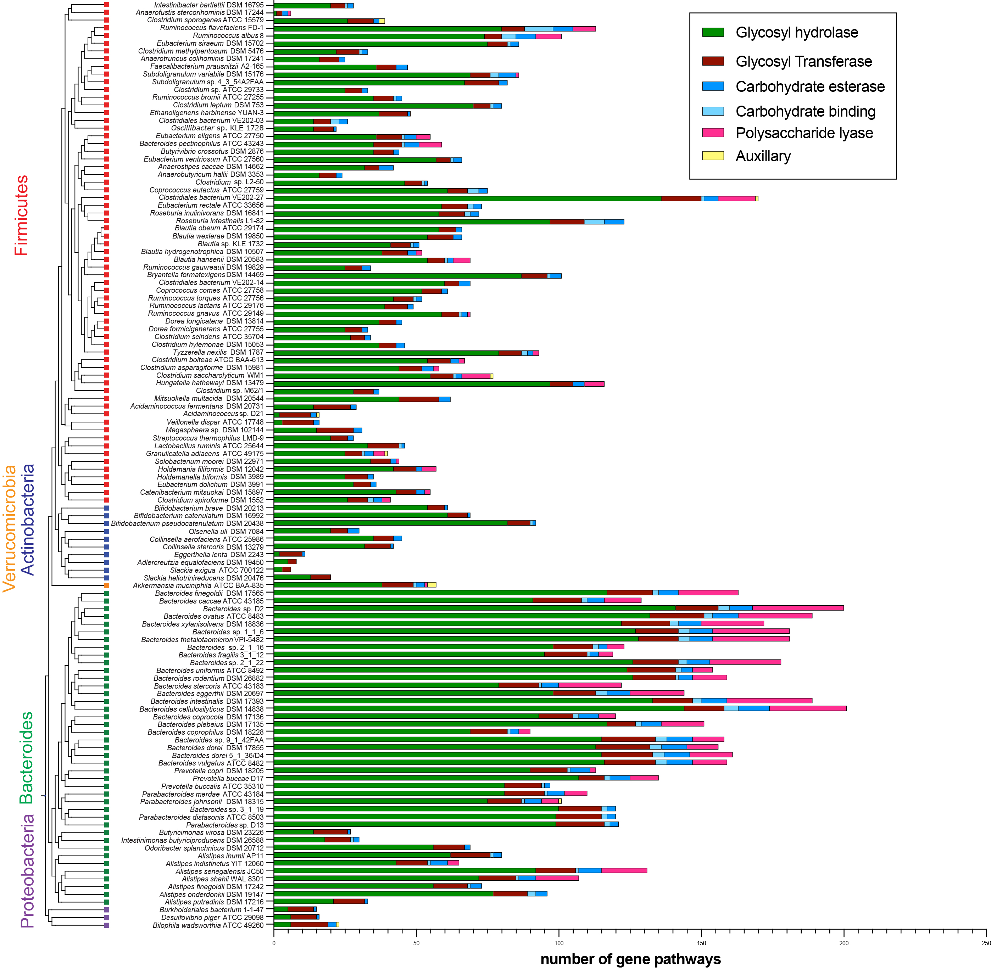
Genomic prediction of hCom2 polysaccharide metabolic capacity
Andrew Freiberger Chris Henry

Slide 6
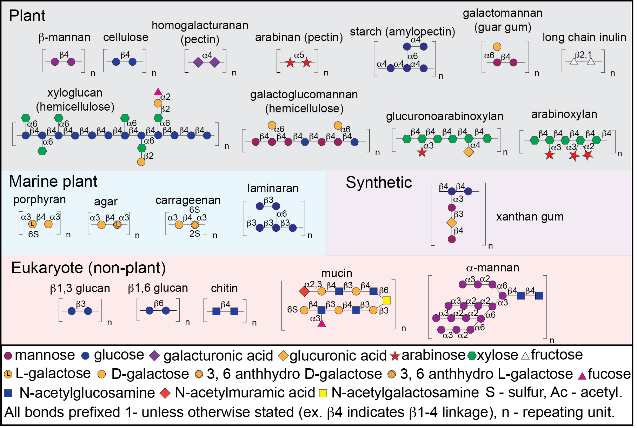
Most common dietary fibers

Slide 7
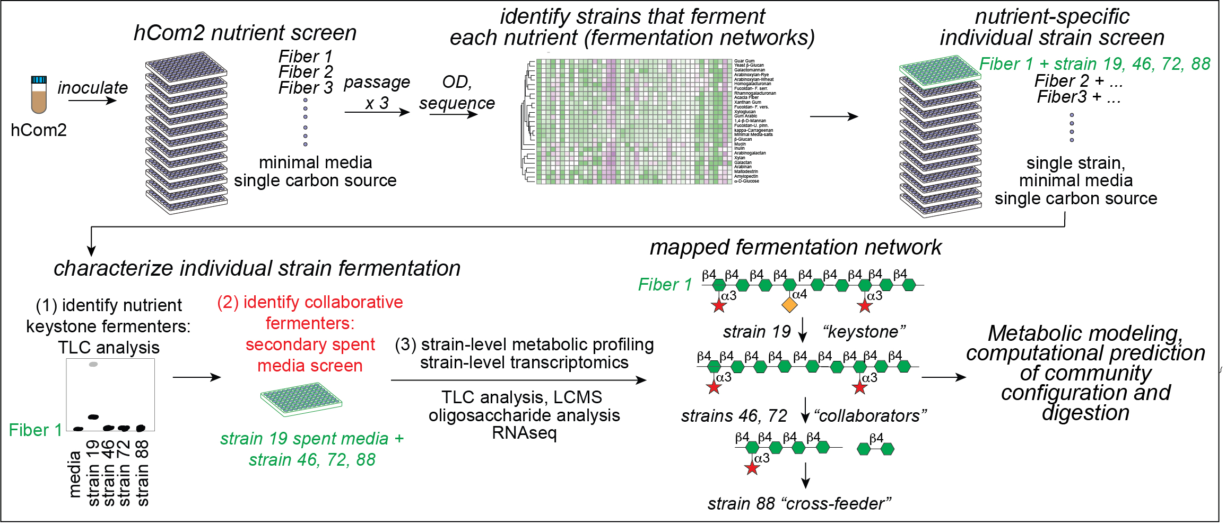

Slide 8
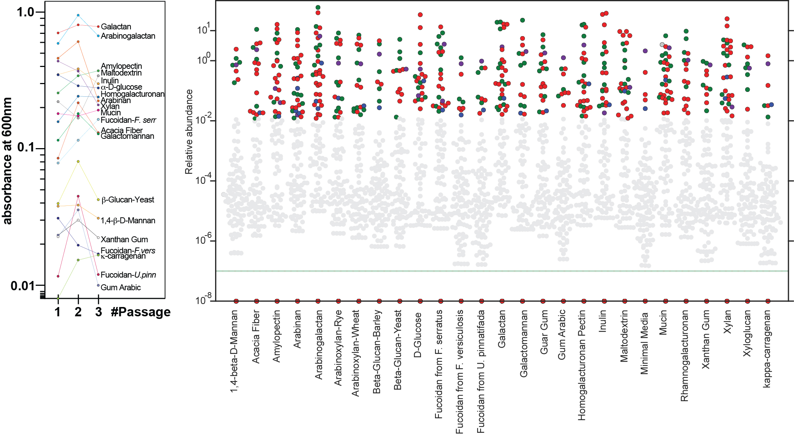

Slide 9
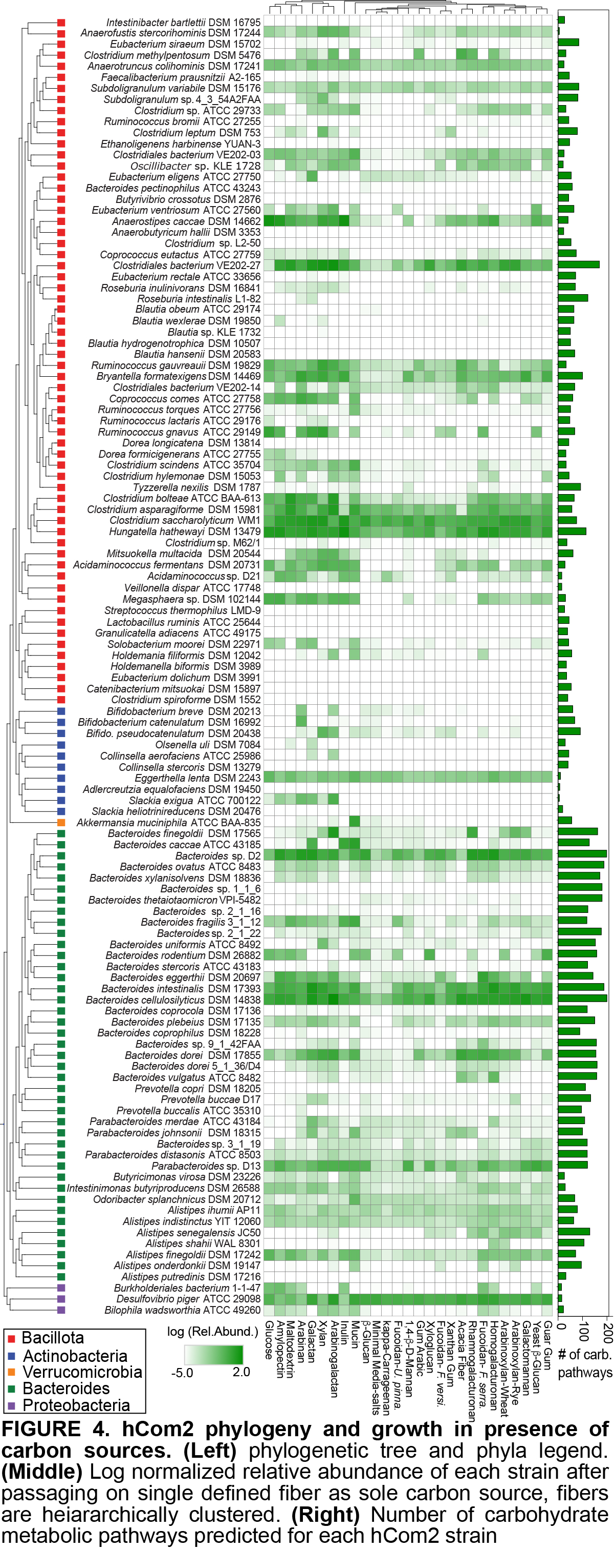
No. of carbohydrate genetic pathways

Slide 10
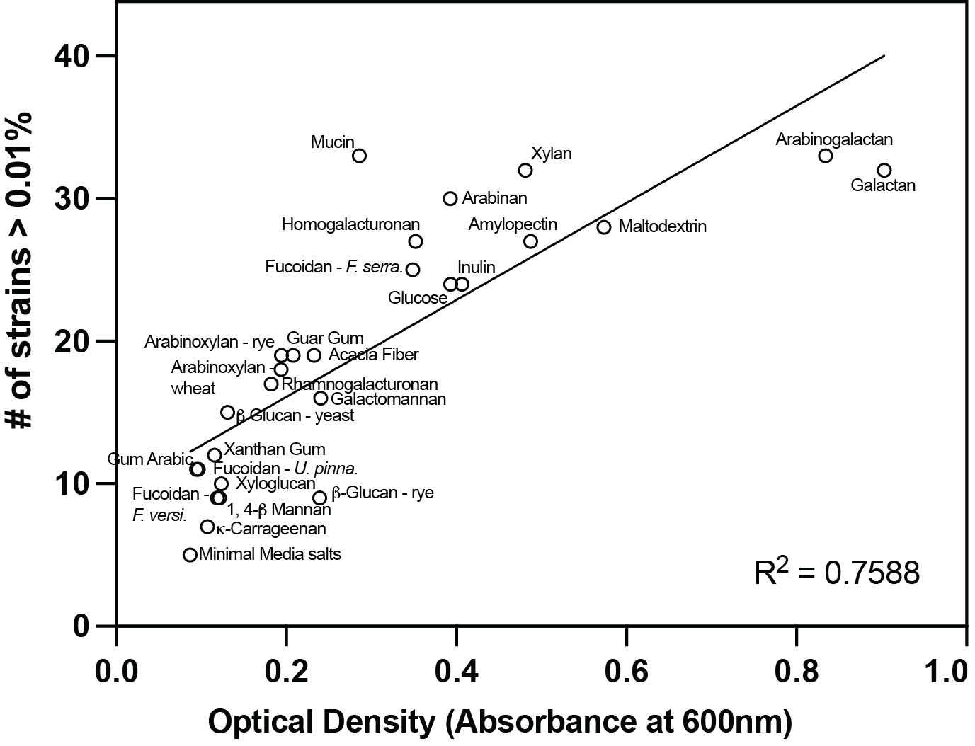

Slide 11
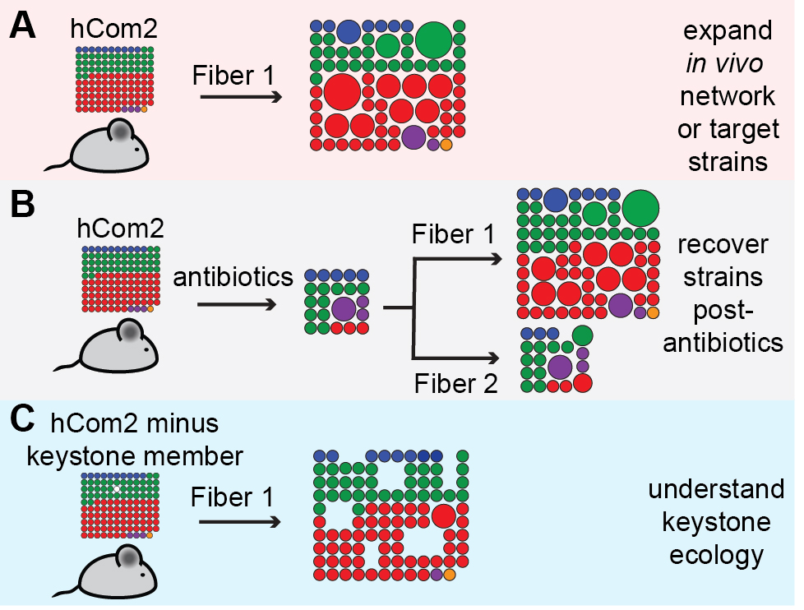
Next steps
Paper 1:
Chemically map select fiber networks
Investigate ecology as pertains to digestion (how does fiber change community composition and recovery)
Physically map fiber networks (in vivo) through spatial transcriptomics
Paper 2: Metabolic modeling of community fermentation
Apply to PD1 inhibitor models..?
Translate to patient populations?
Notes:
PD1 – CD8 cells (PD1 in context of T1DM)
Do therapies modulating PD1/PDL1 stimulate cancer?
Effector cells – use fibers to stimulate/screen for stimulation of effector cells?
Rheumatology – effects of checkpoint inh on autoimmune disease (punkthee); PD1

